Slide 1
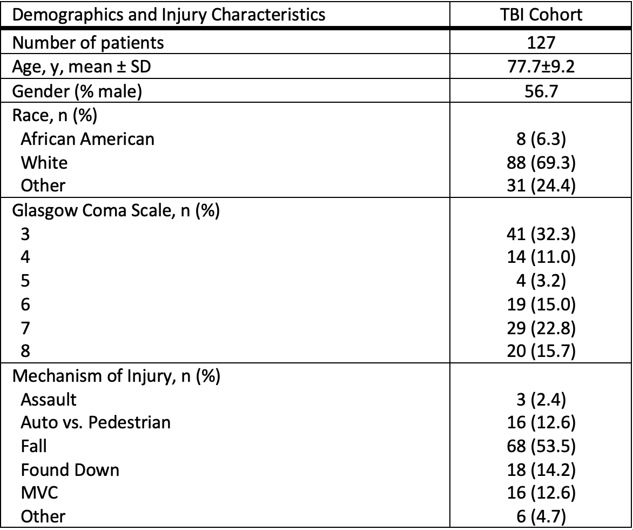
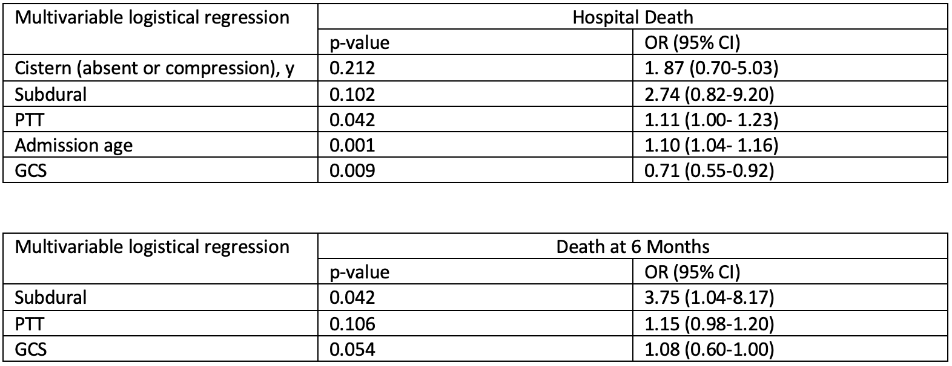
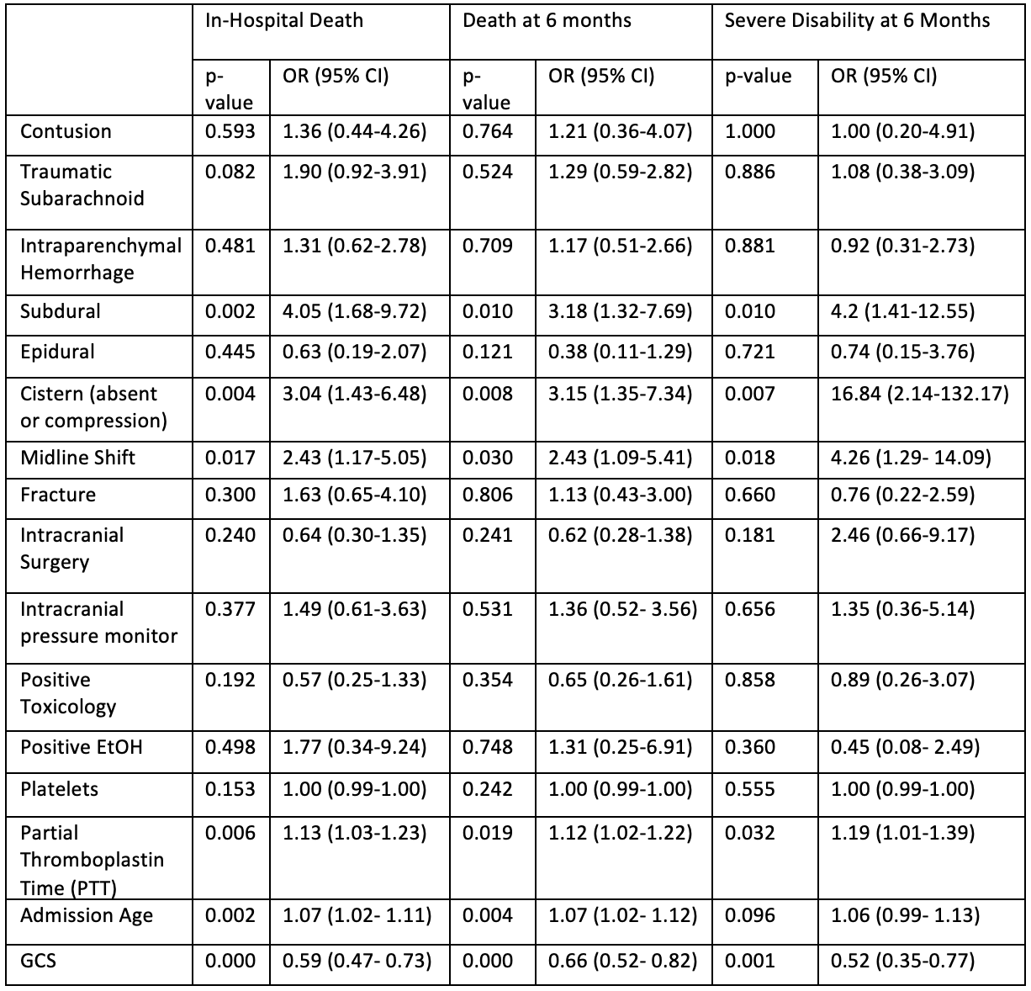
Geriatric Traumatic Brain Injury:
Risk Factors of Morbidity and Mortality
Ernesto Rivera,¹ & Ryan Martin^{2,3}
¹ UC Davis School of Medicine, ² Neurosurgery, UC Davis, ² Neurology, UC Davis
Background
Results
Table 3. Multivariate Logistical Regression at Hospital Discharge and 6 Months
.
Older adults have the highest incidence of traumatic brain injury (TBI) of any age-group.¹
Patients aged 65 and older comprise 15% of the population and account for 50% of TBI deaths²
Few studies have examined risk factors of morbidity and mortality in elderly, TBI patients
Table 1. Demographics & Injury Characteristics
Multivariate analysis demonstrates PTT, subdural, GCS, and age as statistically significant predictors of mortality at different timepoints (Table 3)
Aim
Table 2. Univariate Logistical Regression of Mortality & Morbidity at Hospital Discharge and 6 Months After Injury
Conclusions
Reconfirmed that age and GCS are strong predictors of mortality after traumatic brain injury.
Subdural hemorrhage and prolonged PTT are strong predictors of morbidity and mortality in elderly patients with severe TBI.
Future studies should examine the effects of CT pathology and coagulopathy on mortality and morbidity of elderly patients with mild and moderate TBI.
Determine risk factors of severe disability and mortality in elderly patients with severe traumatic brain injury.
Methods
Study Design: A retrospective analysis of 127 elderly patients, aged 65 and older, presenting to the UC Davis Medical Center with a severe traumatic brain injury (Glasgow Coma Scale of 3-8)
Patient/injury characteristics: See Table 1.
6-month outcomes: Glasgow Outcome Scale-Extended (GOSE) was used to assess severe disability, which was defined as a GOSE score≤4
Analysis: Univariate logistical regression was performed to identify predictors that were statistically significant. Multivariable logistical regression was then performed at 6 Months with the predictors considered statistically significant.
.
Univariate logistical regression demonstrates subdural hemorrhage, cistern effacement, midline shift, PTT, age and GCS as statistically significant predictors of morbidity and mortality at hospital discharge and 6 Mo (Table 2)
References
Taylor CA, Bell JM, Breiding MJ, Xu L. Traumatic Brain Injury–Related Emergency Department Visits, Hospitalizations, and Deaths — United States, 2007 and 2013. MMWR Surveill Summ 2017.
Garza N, Toussi A, Wilson M, Shahlaie K, Martin R. The Increasing Age of TBI Patients at a Single Level 1 Trauma Center and the Discordance Between GCS and CT Rotterdam Scores in the Elderly. Front Neurol. 2020;11:112. Published 2020 Feb 20. doi:10.3389/fneur.2020.00112
Funding/Disclosures
Funding was provided by the National Center for Advancing Translational Sciences, National Institutes of Health, through Grant No. UL1 TR001860
Notes:
48x36 ; Font
References

